Slide 1
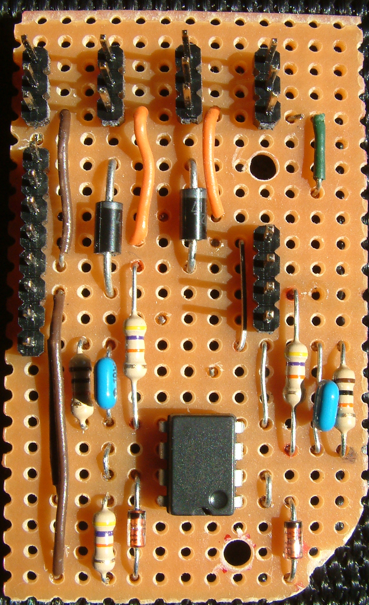
Interconnect / Dual Battery Minimum Voltage Sensor
Component Side
Dror & Itai Caspi, June 23, 2009
J3
Front
J4
Rear
J5
Left
J6
Right
3
3
3
3
ESC -
2
2
2
2
ESC +
J1
1
1
1
1
ESC PWM
9
Vbat + Out
8
J2
Right In
7
Left In
6
D6
Rear In
5
D5
4
Battery 2 -
Front In
4
3
Battery 2 +
Bat Sense Out
3
2
Battery 1 +
5V In
2
1
Battery 1 -
R12
GND Out
1
R11
R10
R9
C2
C1
U1
D8
D7
R13

